Slide 1







Playing with Tiny bit
Wobble when touch
Yahboom

Slide 2









Contents
Preparation
Learning goal
Search for blocks
Combine blocks
Experimental phenomena
Yahboom

Slide 3

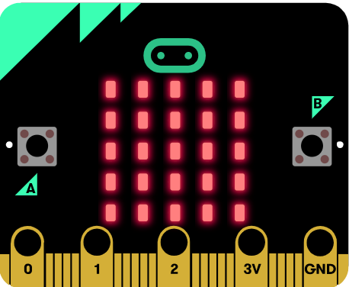
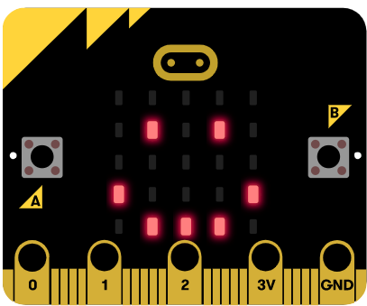
Preparation
This course mainly uses the geomagnetic sensor that comes with micro:bit. In addition to detecting the strength of the earth's magnetic field, the geomagnetic sensor can also be used as an electronic compass to determine the direction.
! ! ! Note: If you have an experiment with a geomagnetic sensor, we must calibrate compass because the local magnetic field is different at each location and has large effect on the results.
When the program download is complete, micro:bit will prompt calibration, the screen (LED dot matrix) prompts: “TILT TO FILL SCREEN”, then enters the calibration interface.
The calibration method is: Tilt the micro:bit, make 5x5 dot matrix on the micro:bit board is all lit, as shown in the following figure:
Then a smile will appear on the micro:bit dot matrix to indicate that the calibration is complete.
Yahboom

Slide 4
Preparation
Programming method:
Mode 1 online programming: First, we need to connect the micro:bit to the computer by USB cable. The computer will pop up a USB flash drive and click on the URL in the USB flash drive: http://microbit.org/ to enter the programming interface. Add the Yahboom package: https://github.com/YahboomTechnology/Tiny-bitLib to program.
Mode 2 offline programming: We need to open the offline programming software. After the installation is complete, enter the programming interface, click【New Project】, add Yahboom package: https://github.com/YahboomTechnology/Tiny-bitLib, you can program.
Yahboom

Slide 5
Learning goal
1.Learn how to use compass graphically program building blocks
2.The function is realized by programming: When the angle of the micro:bit compass id changed, the Tiny-bit will wobble and the buzzer will sound.
Yahboom

Slide 6

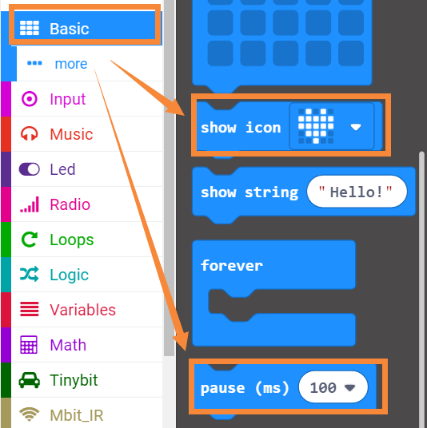
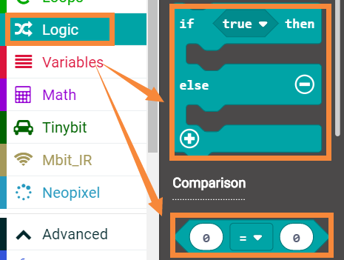
Search for block
The following is the location of the building blocks required for this programming.
Yahboom

Slide 7
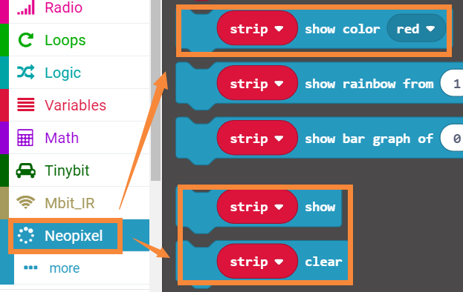
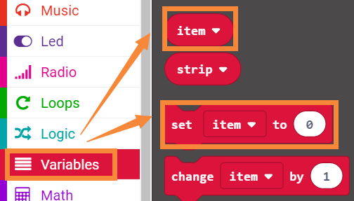
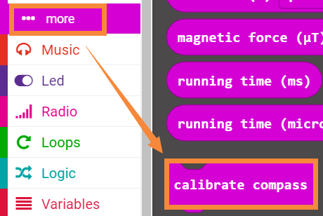
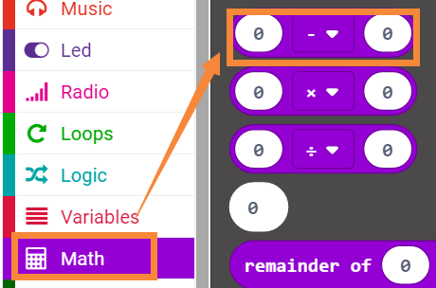
Search for block
Yahboom

Slide 8
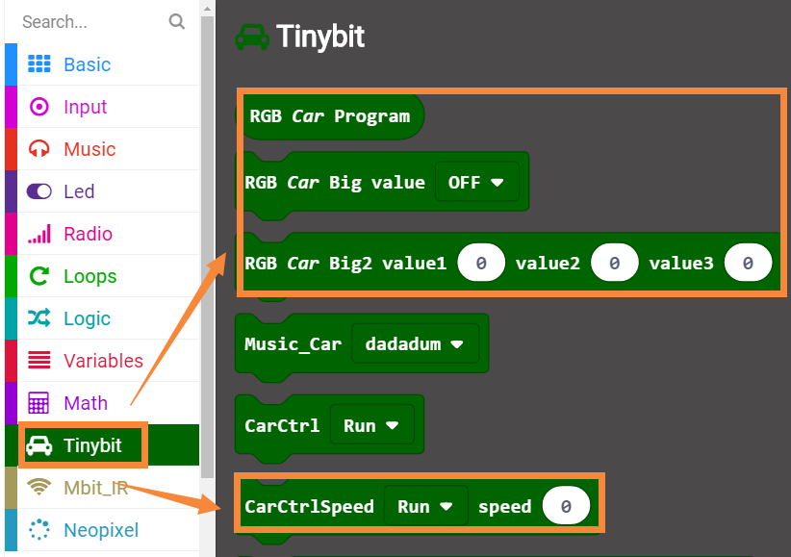
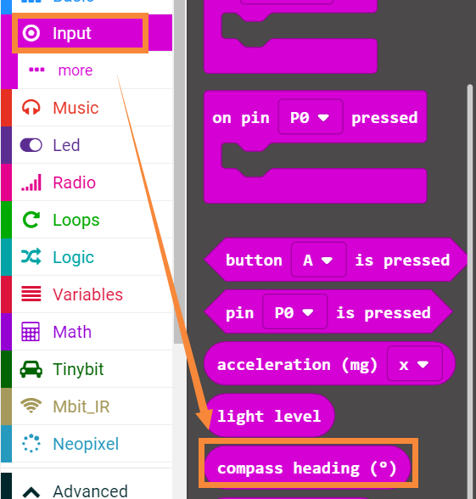
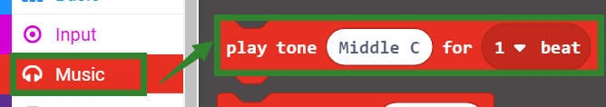
Search for block
Yahboom

Slide 9
Combine block
The summary program is shown below:
Please see microbit-Wobble-when-touch.hex for the program
Yahboom

Slide 10
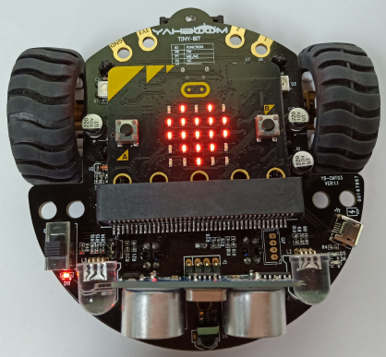
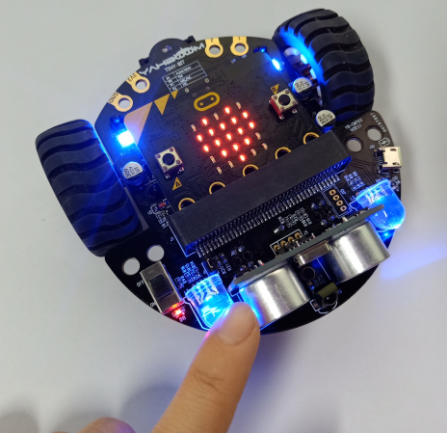
Experimental phenomena
After the program is downloaded, open the power of robot car.
1. Complete the calibration of the compass according to the method in the 【preparation.】
2. After two seconds, the micro:bit dot matrix will display heart as shown in Figure 1. Tiny-bit will stand still.
3. When we gently push Tiny-bi by our hand (changing the angle of the current compass), the micro:bit dot matrix will display the pattern of the chess board, while lights become blue, as shown in Figure 2 below. Tiny-bit will wobble for a while, then it will keep still. the micro:bit dot matrix will display heart and the lights will go out, and the buzzer will make a sound.
Figure 1
Figure 2
Yahboom

Slide 11
Inspire Creativity Embrace Innovation
Thank you!!!

